Slide 1
S V M
Support vector machine
Notes:
http://minheeblog.tistory.com/category/PPT

Slide 2
목차
01 02 03 04
SVM
Hard margin SVM
Soft margin SVM
Nonlinear classification
Notes:
http://minheeblog.tistory.com/category/PPT

Slide 3
SVM
01
“ ”
SVM (support vector machine)
The SVM algorithm creates a model that determines which class the new data belongs to based on the training data.
- If the data is given as a p-dimensional vector, check whether the data can be classified as a (p-1)-dimensional hyperplane.
Notes:
http://minheeblog.tistory.com/category/PPT

Slide 4
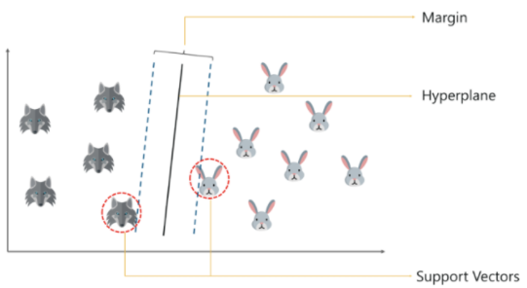
SVM
01
Decision boundary(hyperplane) is boundary that separates classes
Support vector is the data closest to the hyperplane in each class.
Margin is the sum of the distance between the support vector of each class and the hyperplane.
Notes:
http://minheeblog.tistory.com/category/PPT

Slide 5
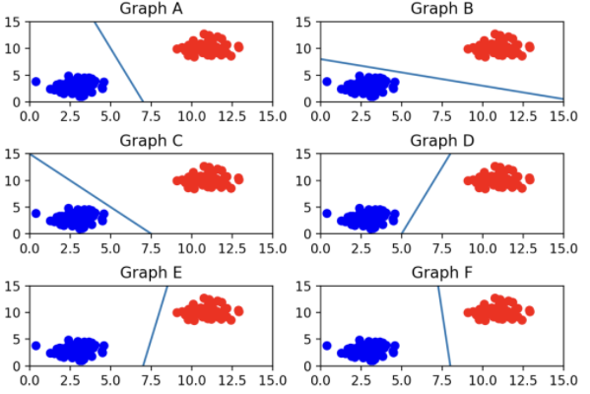
SVM
01
Best hyperplane
A, B, and C are close to blue.
D and E are closer to red and blue than F.
▶ At F, the margin is maximum.
Notes:
http://minheeblog.tistory.com/category/PPT

Slide 6
Hard margin
02
“ ”
Hard margin
A classification without errors when it can be classified linearly is called a hard margin.
In three dimensions, normal vector =(a,b,c), distance from the origin = d
-> ax+by+cz+d=0.
in two dimensions, for a vector w=(a,b) perpendicular to the straight line, the equation of a straight line with a distance d from the origin becomes
-> ax+by+d=0.
▶ Using a normal vector and an arbitrary real number we can define a hyperplane.
Notes:
http://minheeblog.tistory.com/category/PPT

Slide 7
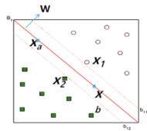
Hard margin
02
Hyperplane: w^{T}x+b=0
w^{T}x₁+b>=q , w^{T}x₂+b<=q
normalization
w^{T}x₁+b>=1 , (y_{i}=1)
w^{T}x₂+b<=-1 , (y_{i}=-1)
y_{i}(w^{T}x+b)-1>=0
Notes:
http://minheeblog.tistory.com/category/PPT

Slide 8
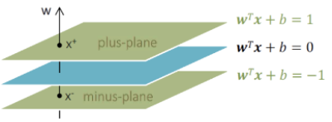

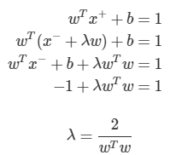
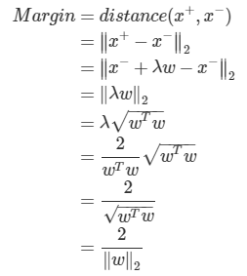
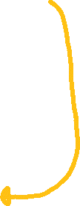
Hard margin
02
1 2 3
Notes:
http://minheeblog.tistory.com/category/PPT

Slide 9






Hard margin
02
1.
2.
KKT conditions
Stationarity
3.
4.
Notes:
http://minheeblog.tistory.com/category/PPT

Slide 10
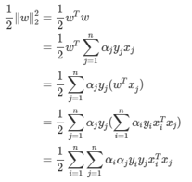
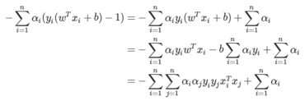


Hard margin
02
Notes:
http://minheeblog.tistory.com/category/PPT

Slide 11




Hard margin
02
KKT conditions
Complementary slackness:
support vector
not support vector
1.
2. w^{T}x_{sv}+b=y_{sv}
Notes:
http://minheeblog.tistory.com/category/PPT

Slide 12




Hard margin
02
Notes:
http://minheeblog.tistory.com/category/PPT

Slide 13
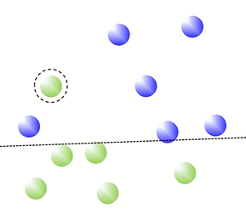
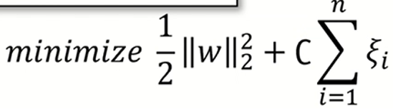

Soft margin
03
Soft margin
1.
2.
Notes:
http://minheeblog.tistory.com/category/PPT

Slide 14
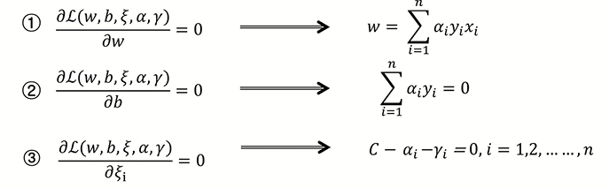
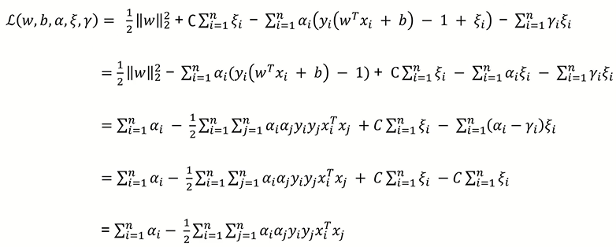
Soft margin
03
1.
2.
Notes:
http://minheeblog.tistory.com/category/PPT

Slide 15
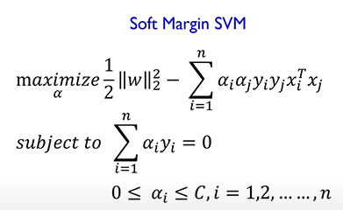




Soft margin
03
3.
4.
not support vector
support vector
Notes:
http://minheeblog.tistory.com/category/PPT

Slide 16
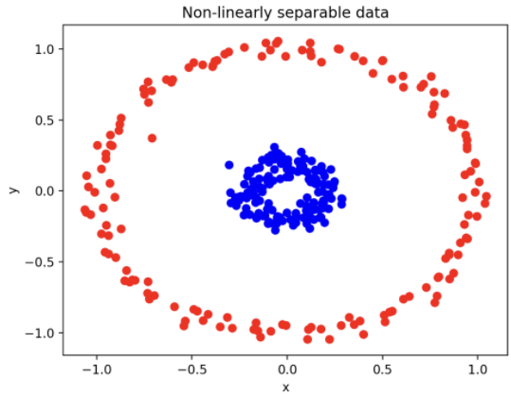
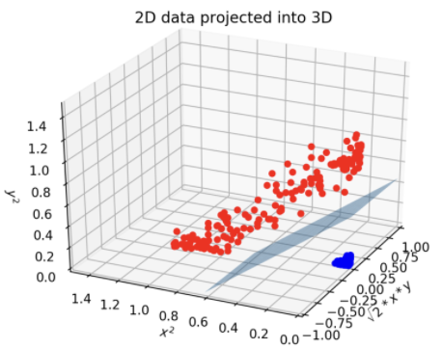
Nonlinear classification
04
“ ”
Nonlinear classification
SVM nonlinear classification makes it possible to classify by converting it to high-dimensional data when it cannot be classified linearly.
- In order to prevent an increase in the amount of computation when converting data to a higher dimension, an SVM structure that defines a kernel function can be designed to efficiently calculate the dot product operation.
Notes:
http://minheeblog.tistory.com/category/PPT

Slide 17
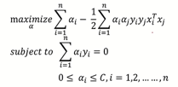
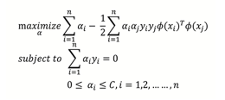




Nonlinear classification
04
Linear kernel
Polynomial kernel
Sigmoid kernel (Hyperbolic tangent kernel)
Gaussian kernel (radial basis function (RBF) kernel)
Notes:
http://minheeblog.tistory.com/category/PPT

Slide 18


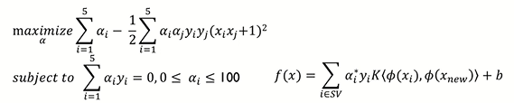



Nonlinear classification
04
Kernel function
1.
2.
3.
Notes:
http://minheeblog.tistory.com/category/PPT

Slide 19
THANK
YOU
Notes:
http://minheeblog.tistory.com/category/PPT

